Slide 1
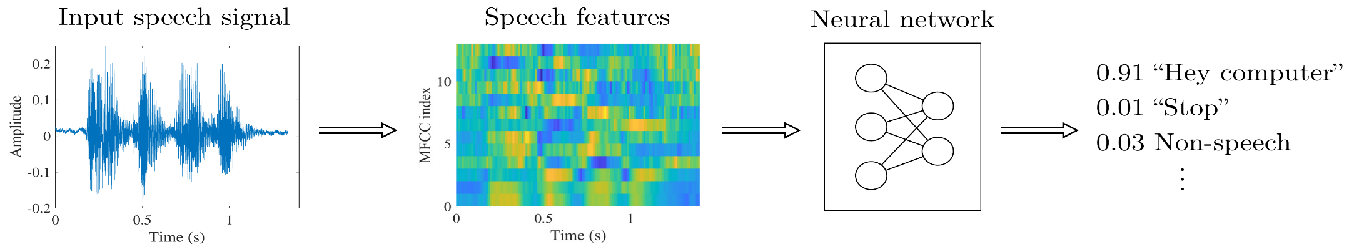
Keywords Spotting in real time
Brief :
Spoken keyword spotting (KWS) deals with the identification of keywords in audio streams in low latency or in real time
Challenge :
Small footprint
Low computational complexity
Low latency
High accuracy (Large receptive field of audio features)
Team
Arun Kumar Pradhan
Kathir Ravichandran
Madhan Gowrinathan

Slide 2
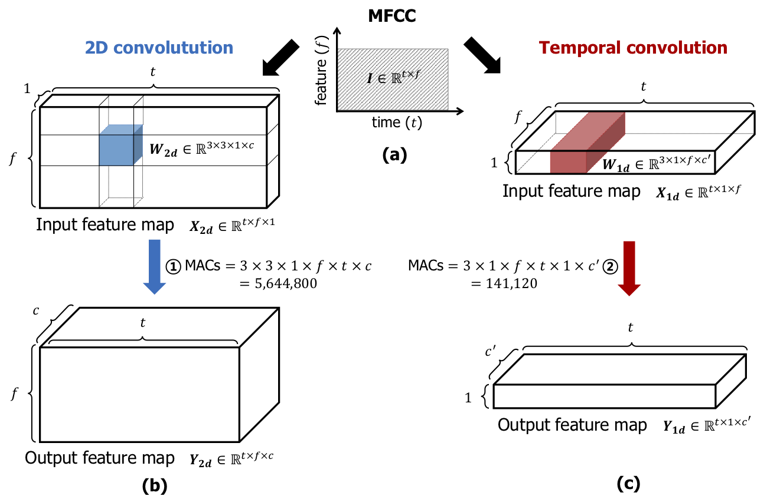
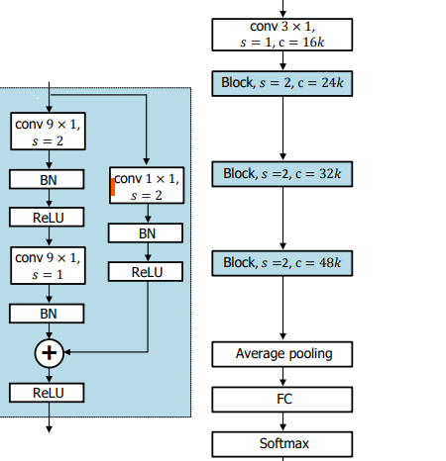
Model 40 MFCC features (window : 30ms, time shift :10 ms)extracted from Audio stream Instead of 2D, dilated 1D convolution reduces complexity RestNet8 with Temporal convolution : TC-RESNET8

Slide 3
Tools ,Data Set and Training
Tools : Python 3.6.8 , TensorFlow 1.13.1
Data set :
Google Speech Commands Dataset .The dataset contains 64,727 one-second-long utterance files which are recorded and labeled with one of 30 target categories.
Data split : 80-10-10
Key words Targeted :
we distinguish 12 classes: “yes”, “no”, “up”, “down”, “left”, “right”, “on”, “off”, “stop”, “go”, silence, and unknown.
Total training Time: 4 hours and 35 minutes
Training Environment: AWS EC2 m5.2xlarge (32 GiB GiB RAM + 8 vCPU)
Model complexity reduction ( Pruning , Quantization ) : TensorFlow Lite

Slide 4
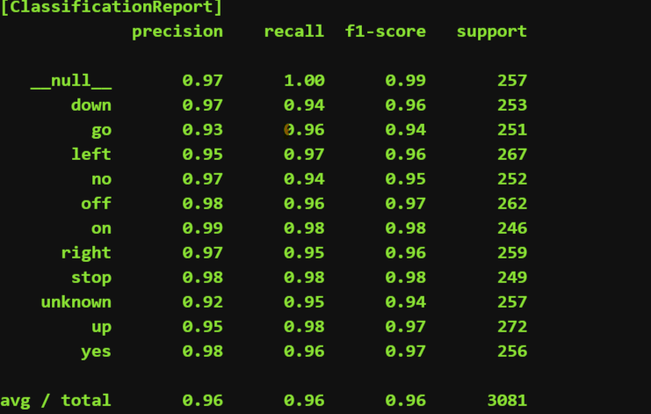
Model performance and complexity
Model | Accuracy (%) | Time(ms) | FLOPS | PARAMS
TC-RESNET8 | 96.1 | 1.1 | 3.0M | 66K
Vs
Model | Accuracy (%) | Time (ms) | FLOPS | PARAMS
CNN | 90.7 | 32 | 76.1M | 524K

Slide 5
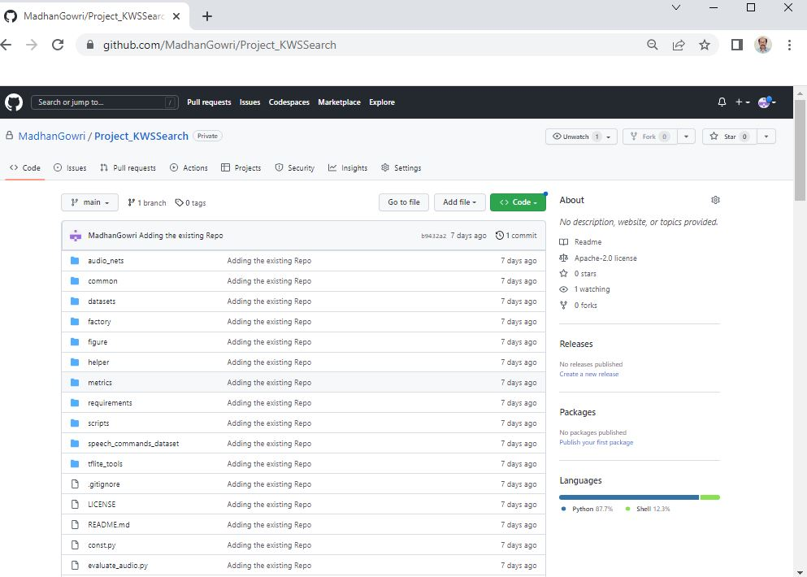
Code repository and Future scope github.com/MadhanGowri/Project_KWSSearch
Further scope :
Model compression and quantization using tflite /Android
Model implementation on Android device for Inference
Model implementation on low footprint DSP for Inference

